Slide 1
RTrack: RNN-Based Device-Free Motion Tracking Wenguang Mao, Mei Wang, Wei Sun, Lili Qiu, Swadhin Pradhan, Yi-Chao Chen UT Austin

Slide 2

Smart Speaker
24% US households have smart speakers and 40% of them own multiple smart speakers
Speech-based interaction is used
Quiet environments
Noisy environments
Complicated operations

Slide 3
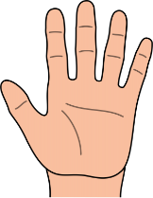
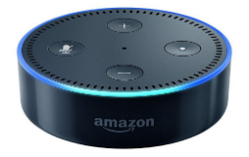
Smart Speaker
24% US households have smart speakers and 40% of them own multiple smart speakers
Speech-based interaction is used
Gesture based interaction is needed
Quiet environments
Noisy environments
Complicated operations

Slide 4

Acoustic Device-Free Tracking
Potentials
Problems
High accuracy
Low cost
Privacy preserving
Limited working range
Not leverage the smart speaker setup

Slide 5
Why Limited Working Range

Slide 6
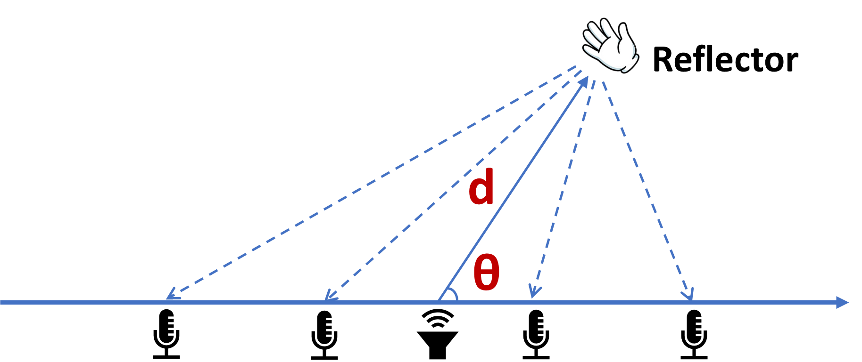
2D MUSIC
Leverage microphone array on smart speakers
Sending inaudible chirp signals
Mixing tx and rx chirps
$$s\left(n, t\right)=cos⁡(Ω\left(θ\right)⋅n+ω\left(d\right)⋅t+φ)$$
MIC index
Time
Frequencies

Slide 7
Our Signal Processing
2D profile enhancement
Time-domain beamforming
MIC placement design
Using middle chirps
Removing negative frequencies
Detect initial gesture and initialize tracking

Slide 8
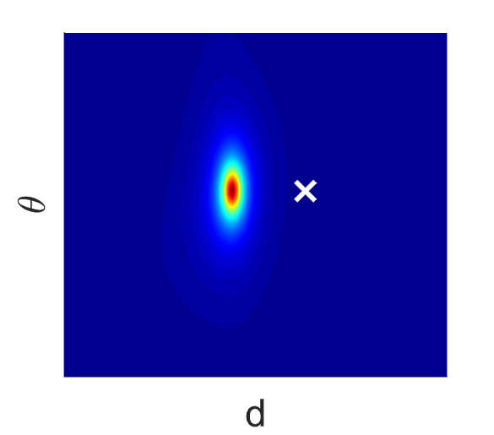
2D Profiles
Our Signal
processing
Audio signals

Slide 9
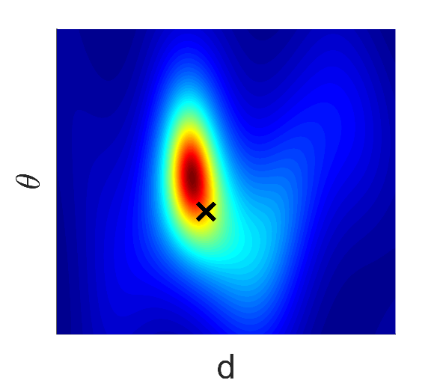
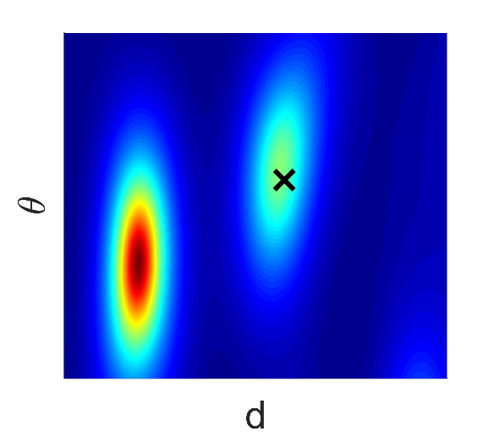
Signal processing alone is not enough
Under noise
Under multipath
Under movement
X is the ground truth position

Slide 10
Our Approach
Received signals
Target position
RTrack
Signal Proc.
RNN
Separate target reflection from others
Exploit temporal relationship

Slide 11
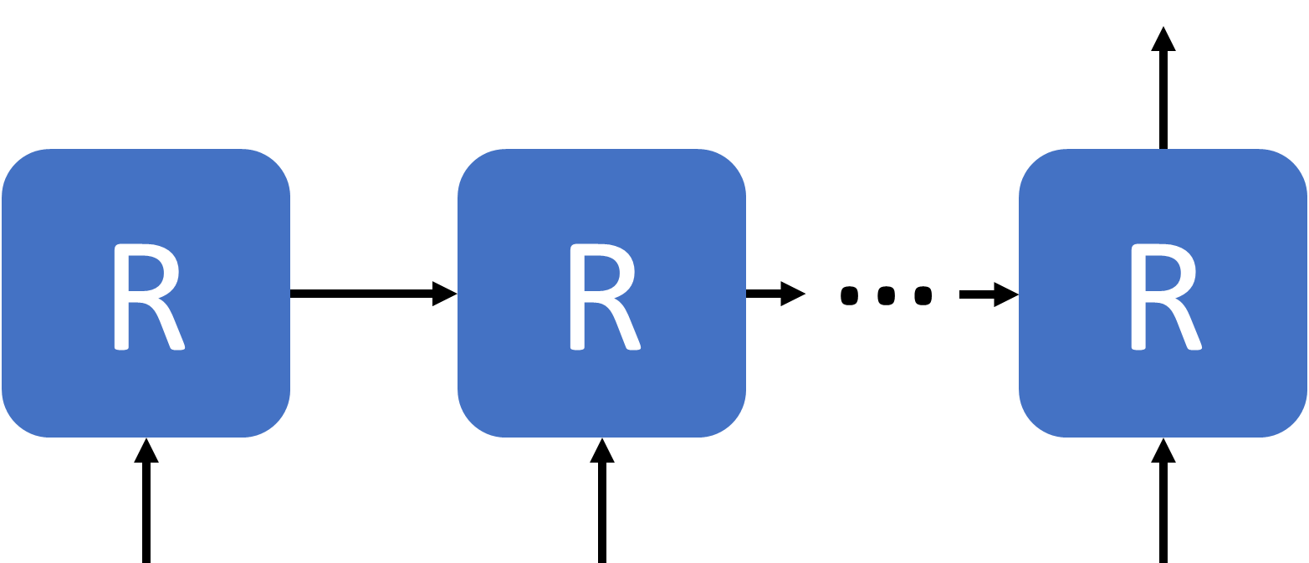
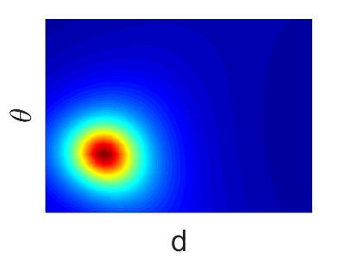
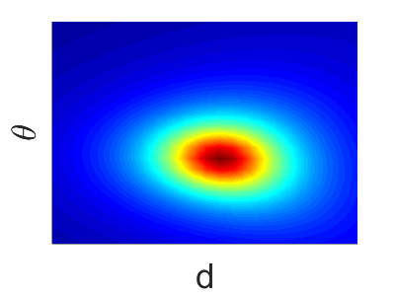
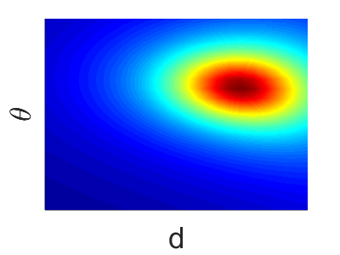
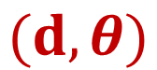
Applying RNN
$$(d, θ)$$
Current profile
Recent profiles

Slide 12
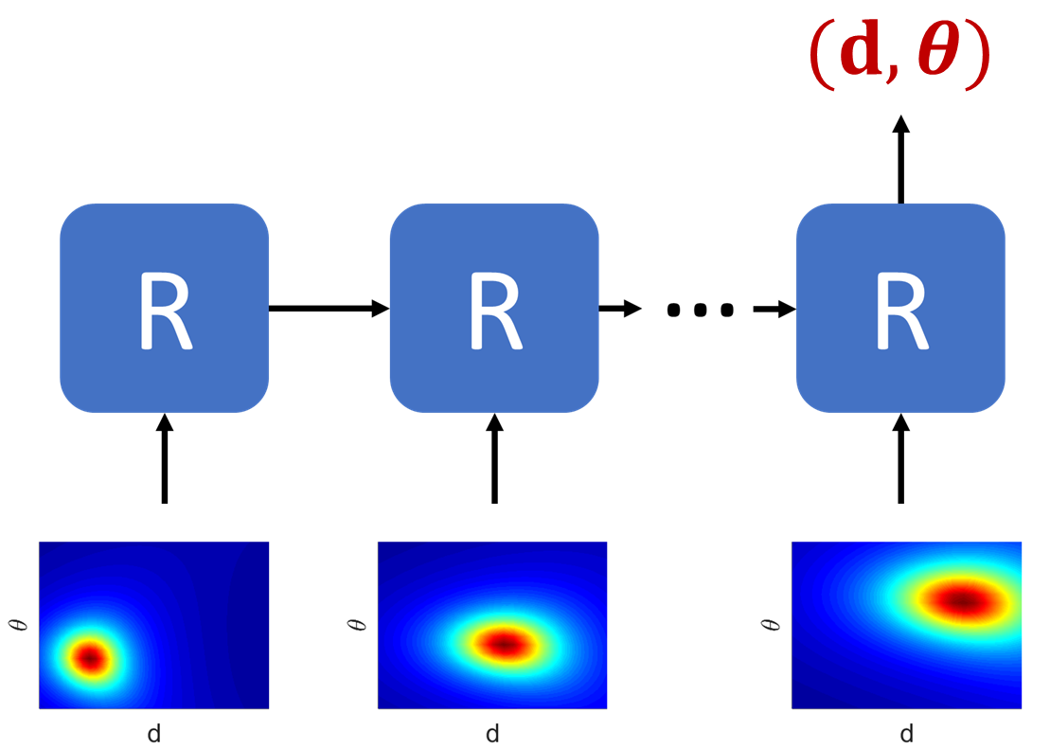
Network Architecture
Dist & AoA
Context info.
O
C
H2
Prev. context
Combine features
H1
R
Extract features
P
Reduce the input size
2D profile

Slide 13
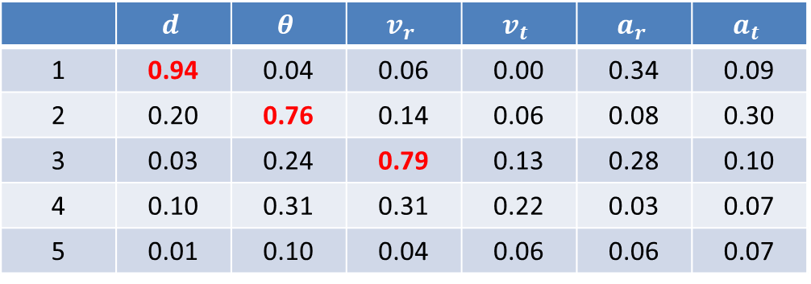
Context Layer
Consist of 5 neurons
 | $$d$$ | $$θ$$ | $$v_{r}$$ | $$v_{t}$$ | $$a_{r}$$ | $$a_{t}$$
1 | 0.94 | 0.04 | 0.06 | 0.00 | 0.34 | 0.09
2 | 0.20 | 0.76 | 0.14 | 0.06 | 0.08 | 0.30
3 | 0.03 | 0.24 | 0.79 | 0.13 | 0.28 | 0.10
4 | 0.10 | 0.31 | 0.31 | 0.22 | 0.03 | 0.07
5 | 0.01 | 0.10 | 0.04 | 0.06 | 0.06 | 0.07

Slide 14
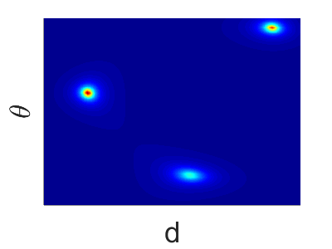




Detection Window
Use a local profile near the target
Isolate environment impacts
Detection window
$$Δd$$
$$\left(Δd, Δθ\right)+ (d_{b}, θ_{b})$$
Save training efforts
$$Δθ$$
Support multiple users
$$(d_{b}, θ_{b})$$
Reduce computation cost

Slide 15
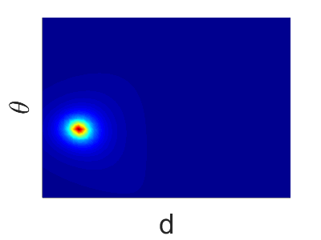
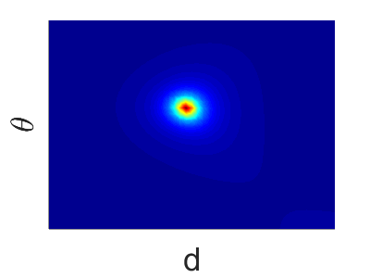
Data Augmentation
Generate more training data with existing data
Our framework is easy to augment data

Slide 16
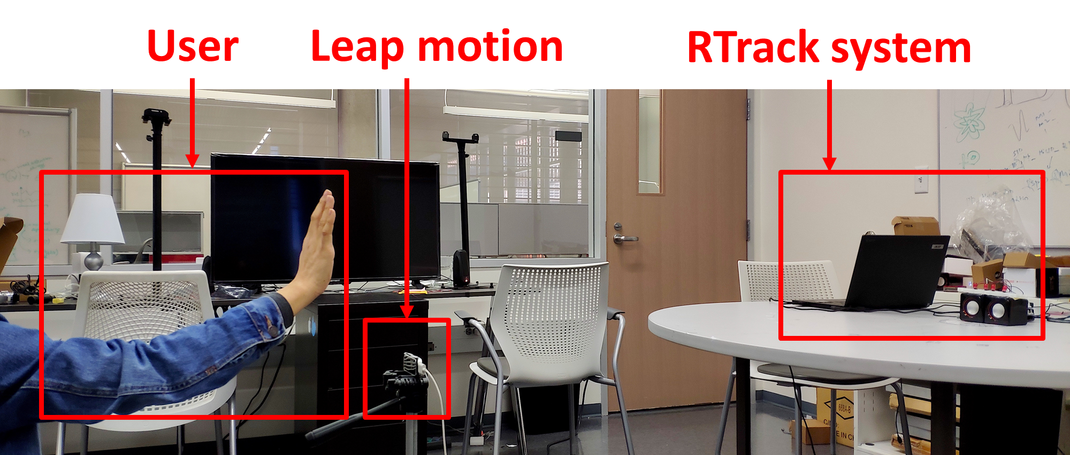
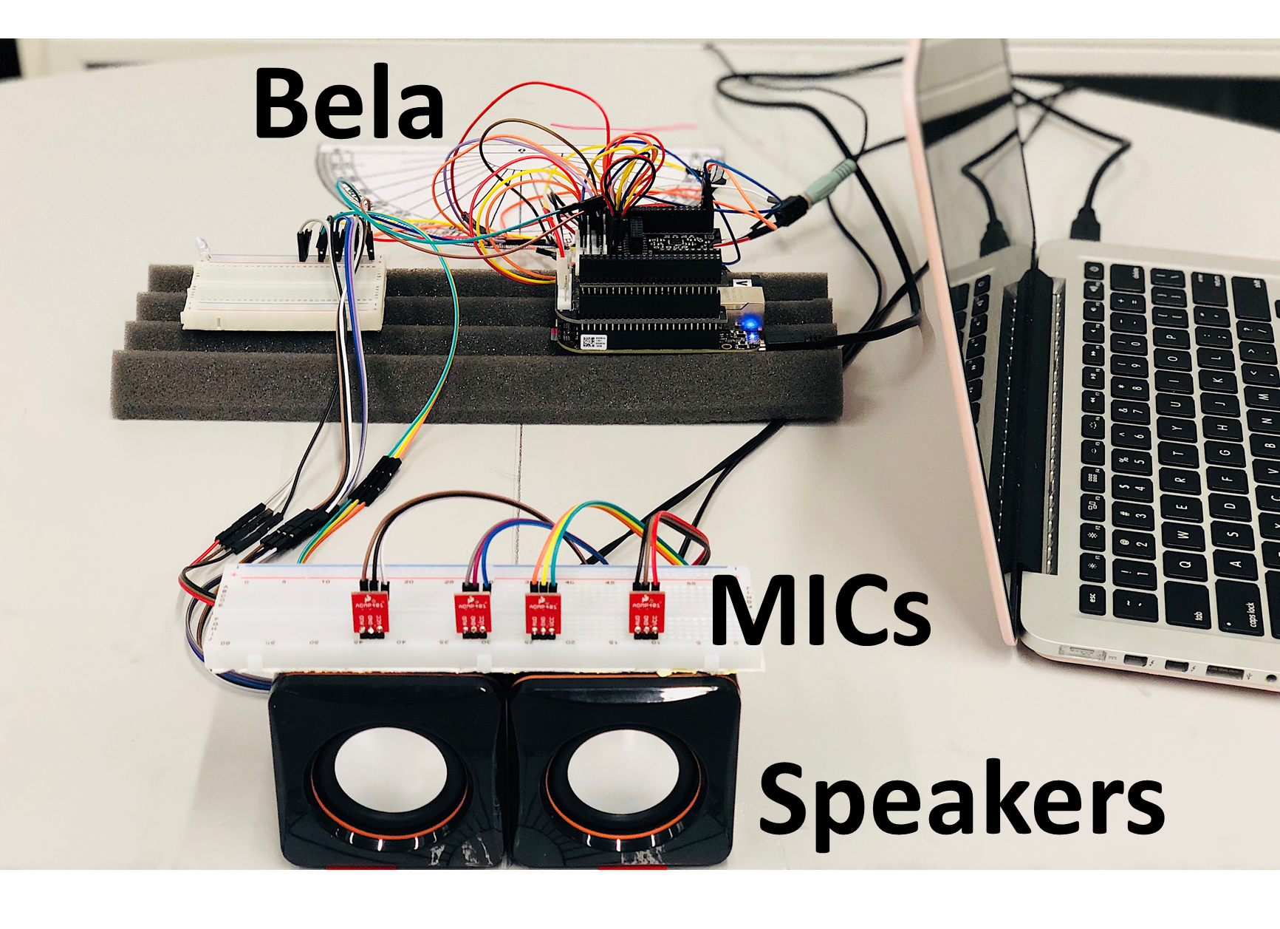
Implementation
Bela-based testbed
Training: 1 user, 1 location
Testing: 9 users, 4 locations
Ground truth: Leap motion

Slide 17
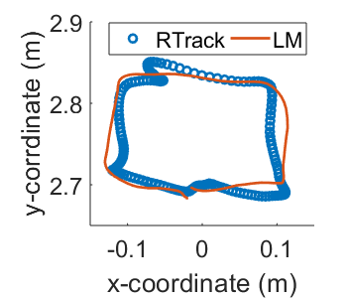
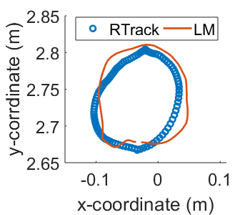
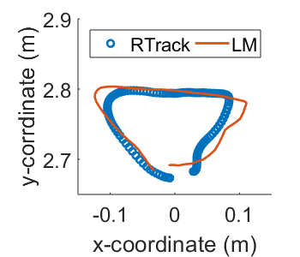
Evaluation
Drawing samples
Accurately capture the hand movement pattern

Slide 18
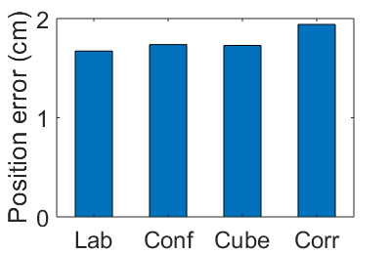
Evaluation
Performance at different locations
Robust to environments

Slide 19
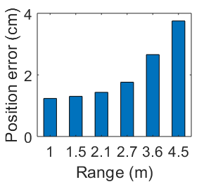
Evaluation
Performance at different ranges
1 – 4 cm error within 4.5 m

Slide 20
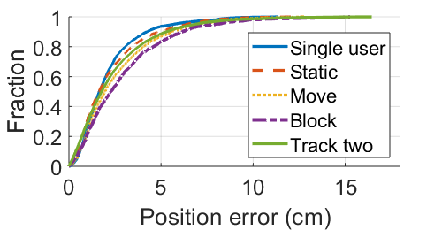
Evaluation
Multi-user experiments
Effectively support multiple users

Slide 21
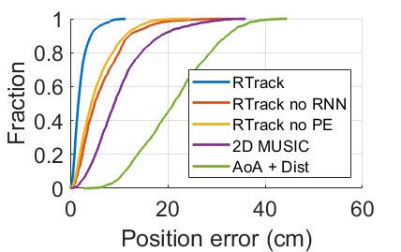
Evaluation
Comparison to baselines
Outperform baseline approaches
Signal proc. and RNN both help

Slide 22
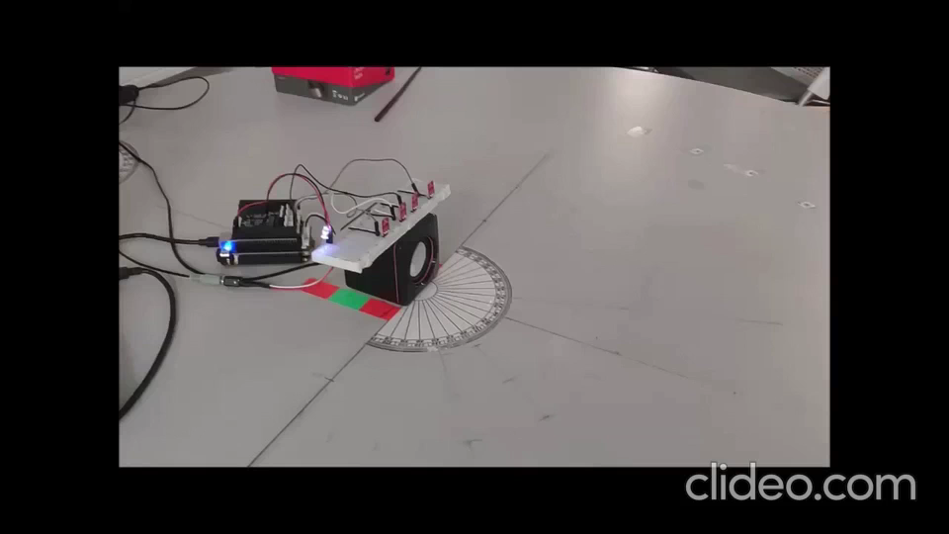
Video Demo

Slide 23
Existing Wireless Tracking
RF based tracking
60 GHz: MTrack@MobiCom’15
RFID: RF-IDraw@SigComm’14, RFind@MobiCom’17, TurboTrack@NSDI’19
WiFi: Chronos@NSDI’16, WiDraw@MobiCom’15, RFPose3D@SigComm’18
Acoustic based tracking
Device-based: AAMouse@MobiSys’15
Device-free: FingerIO@CHI’16, LLAP@MobiCom’16, Strata@MobiSys’17, VSkin@MobiCom’18
The first room-scale device-free acoustic tracking

Slide 24
Thank you!
lili@cs.utexas.edu

